Slide 1
Ensemble
Part 3: Troubleshooting

Slide 2
Troubleshooting
Black Boxes

Slide 3
Troubleshooting
Black Boxes
Where might something go wrong?

Slide 4
Troubleshooting
Black Boxes
Customer Complaint: My web browser can’t connect to my CSP/Zen application.
What are your boxes?
Browser
Web Server
CSP Gateway
Caché

Slide 5
Troubleshooting
Black Boxes
Where might something go wrong?
Web Browser
Web Server
CSP Gateway
Caché

Slide 6
Troubleshooting
Troubleshooting CSP Problems Review
What information is available?
Web Browser
Web Server
CSP Gateway
Caché

Slide 7
Troubleshooting
Troubleshooting CSP Problems Review
What information is available?
Web Browser
Web Server
CSP Gateway
Caché
HTTP errors
Javascript errors
Browser tools

Slide 8
Troubleshooting
Troubleshooting CSP Problems Review
What information is available?
Web Browser
Web Server
CSP Gateway
Caché
Web Server log
Operating system level logs
CSP Gateway logs

Slide 9
Troubleshooting
Troubleshooting CSP Problems Review
What information is available?
Web Browser
Web Server
CSP Gateway
Caché
cconsole.log
SYSLOG
ISCLOG
Read application code
etc

Slide 10
Troubleshooting
Troubleshooting CSP Problems Review
What information is available?
Web Browser
Web Server
CSP Gateway
Caché
Wireshark
tcpdump
iptrace

Slide 11
Troubleshooting
Email Outbound Adapter
Customer Complaint: My Ensemble email operation doesn’t work.
What are your boxes? Ask the customer.
A Business Process
Email Operation
Outbound Email Adapter
Email Server

Slide 12
Troubleshooting
Email Outbound Adapter
What information is available?
A Business Process
Email Operation
Outbound Email Adapter
Email Server
Ensemble Component Settings
Ensemble Event Log
Ensemble Message Viewer
Ensemble Visual Trace
User Code
..SendRequestAsync()/..SendRequestSync()

Slide 13
Troubleshooting
Email Outbound Adapter
What information is available?
A Business Process
Email Operation
Outbound Email Adapter
Email Server
Ensemble Component Settings
Ensemble Event Log
Ensemble Message Viewer
Ensemble Visual Trace
User Code
MessageMap
Method
..Adapter calls
System Trace Events

Slide 14
Troubleshooting
Email Outbound Adapter
What information is available?
A Business Process
Email Operation
Outbound Email Adapter
Email Server
Ensemble Event Log
IOLog
System Trace Events

Slide 15
Troubleshooting
Email Outbound Adapter
What information is available?
A Business Process
Email Operation
Outbound Email Adapter
Email Server
Email server logs
Operating system logs

Slide 16
Troubleshooting
Email Outbound Adapter
What information is available?
A Business Process
Email Operation
Outbound Email Adapter
Email Server
Wireshark
tcpdump
iptrace

Slide 17
Troubleshooting
Email Outbound Adapter
What information is available?
A Business Process
Email Operation
Outbound Email Adapter
Email Server
Ensemble Event Log
cconsole.log
^%ERN, ^ERRORS
SYSLOG
ISCLOG

Slide 18
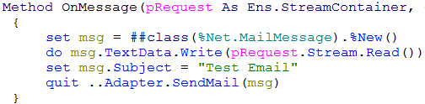
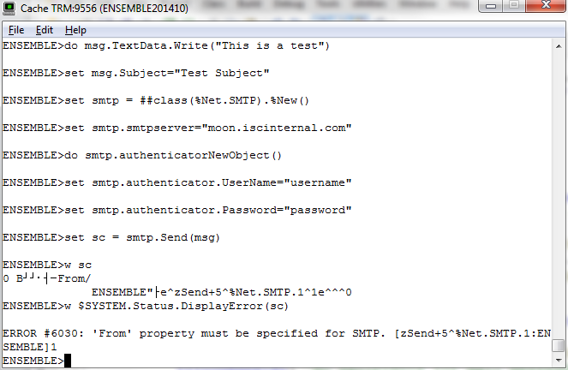
Troubleshooting Ensemble Adapter problems
Determining where the problem is
Try to reproduce the problem by doing in terminal what the adapter code does.
Did you reproduce the problem?
Yes: Problem is outside Ensemble
No: Problem is in customer settings, customer code, or adapter code.
Code and Demo

Slide 19
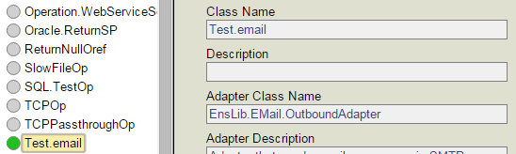
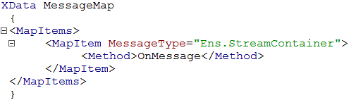

Troubleshooting Ensemble Adapter problems
Looking at the code
Class and Adapter Class
Test.email
EnsLib.EMail.OutboundAdapter
Customer Code
MessageMap
Methods
Ensemble Code
SendMail()
%Net.MailMessage and %Net.SMTP

Slide 20
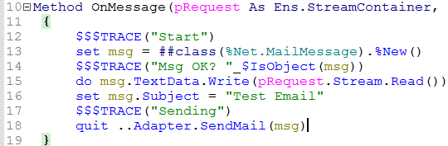
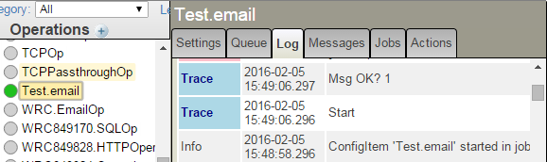
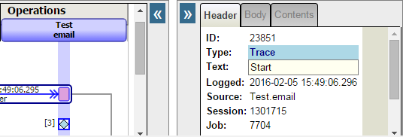

Troubleshooting Ensemble Adapter problems
Debugging with $$$TRACE or with globals
$$$TRACE(“Text”)
Adds “Text” to the Event Log
Timestamped
Blue diamond added to Visual Trace
Optionally, set some globals, run the test, and check the values of the globals

Slide 21
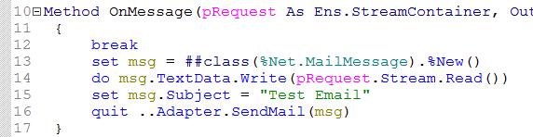
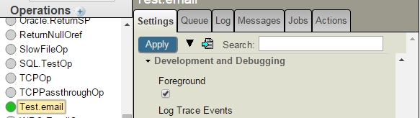
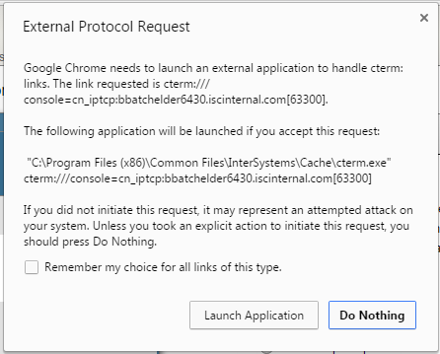
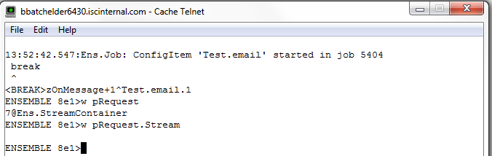
Troubleshooting Ensemble Adapter problems
Debugging with Run in Foreground
Add break statements to your code
Turn on “Foreground” setting
Start the component
Answer “Launch Application” to the “External Protocol Request” pop up (Chrome)
A terminal window will pop open
Reach breakpoint and start debugging

Slide 22
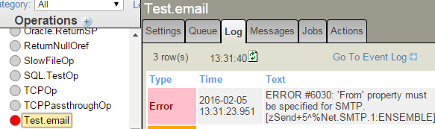
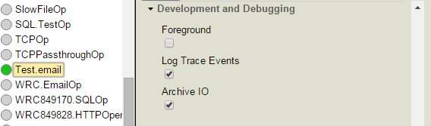
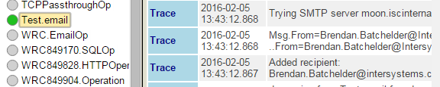
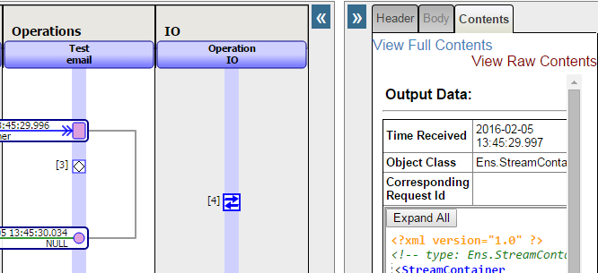
Troubleshooting Ensemble Adapter problems
Some things to look at
Check Event Log for warnings and errors
System Tracing:
Turn on “Log Trace Events” setting
Set `^Ens.Debug(“TraceCat”)=1
Test and look at Event Log
Archive IO:
Input/Output columns added to visual traces

Slide 23
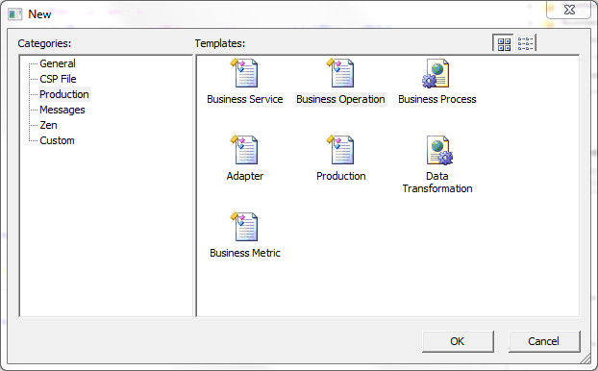
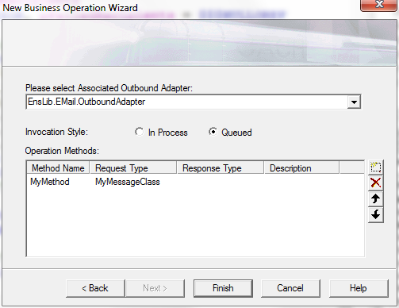

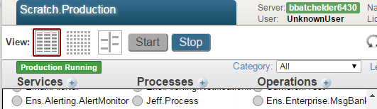
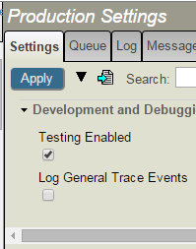
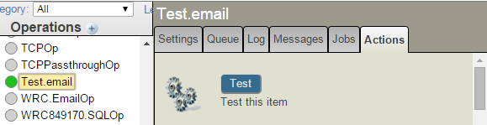
Troubleshooting Ensemble Adapter problems
Testing Operations
New Operation wizard
Add code
Add operation to production
Enable Testing
Start Production
Test Button
1
2
5
3
4
6
Notes:
Note:
Sometimes the testing window isn’t good enough. It can’t handle array or list properties or streams. For cases where the testing window isn’t good enough, it’s still possible to test without having to create a component specifically for testing.
You can set up your test message in terminal and then send it to the component to be tested using the following method:
EnsLib.Testing.Service::SendTestRequest()
Example for an email operation which expects an Ens.StreamContainer:
ENSEMBLE>set msg = ##class(Ens.StreamContainer).%New()
ENSEMBLE>set s = ##class(%Stream.GlobalCharacter).%New()
ENSEMBLE>do s.Write(“Some test data”)
ENSEMBLE>set msg.Stream = s
ENSEMBLE>do ##class(EnsLib.Testing.Service).SendTestRequest(“TargetConfigName”,msg)

Slide 24
Questions?

